Slide 1

DEPARTMENT OF
CSE (ARTIFICIAL INTELLIGENCE AND MACHINE LEARNING)
ACADEMIC YEAR 2025 - 2026
SEMESTER III
ARTIFICIAL INTELLIGENCE LABORATORY
MINI PROJECT REVIEW
<TITLE OF THE PROJECT>
REGISTER NUMBER | 2117240030023
NAME | Derala Chethan kumar
YEAR | 2nd
SECTION | A
FACULTY IN-CHARGE | Mrs. M. Divya

Slide 2
PROBLEM STATEMENT
INTRODUCTION
AI enables machines to learn and make intelligent decisions under uncertainty.
In entertainment, AI powers “movie recommendation systems” that personalize user experiences.
Traditional methods (collaborative & content-based filtering) struggle with ”uncertainty”, missing data, and changing preferences.
The proposed system uses Probabilistic Reasoning (Bayesian Networks)to model uncertainty.
It predicts how likely a user is to enjoy a movie based on ratings, genres, and profiles.
Improves accuracy, personalization, and adaptability of recommendations.
PROBLEM STATEMENT
Users face difficulty choosing from a vast number of movies.
Existing systems fail to handle uncertain or incomplete data effectively.
Need a system that uses probability-based reasoning to predict movie preferences.
Goal: Provide accurate, personalized, and dynamic movie suggestions under uncertain conditions.

Slide 3
THEORETICAL BACKGROUND
Theoretical Background
Artificial Intelligence (AI) helps systems simulate human reasoning and decision-making. In recommendation systems, AI predicts user preferences through data analysis.
Probabilistic Reasoning uses probability theoryto handle uncertainty and incomplete data. It relies on Bayesian Inference, which updates beliefs based on new evidence.
Probabilistic Reasoning & Naive Bayes
Bayes’ Theorem computes the probability of an event (e.g., user liking a movie) based on prior knowledge and observed data.
The Naive Bayes algorithm, derived from Bayes’ Theorem, assumes feature independence and efficiently predicts whether a user will like a movie based on its features (genre, director, ratings, etc.).

Slide 4
IMPLEMENTATION AND CODE
Link to code in Git-hub Repository
List | Git-hub Repository Links
Implementation of Code Link | https://github.com/deralachethankumar/AI-mini-project/blob/c74cad8410789dc3a90264d38bbe9d56aed6f231/AI%20mini%20project%20chethan.py
Word Document Report Link | https://github.com/deralachethankumar/AI-mini-project/blob/main/MergeResult_2025_11_04_06_54_56.docx
PPT Link

Slide 5
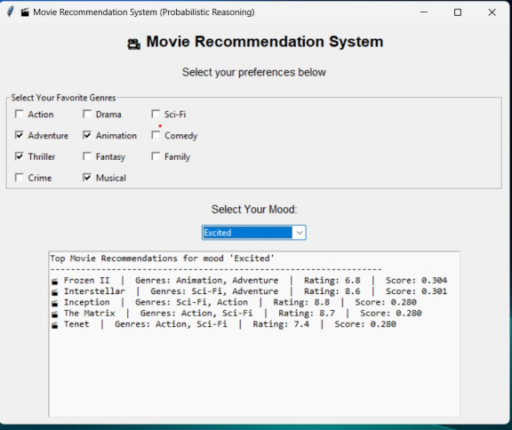
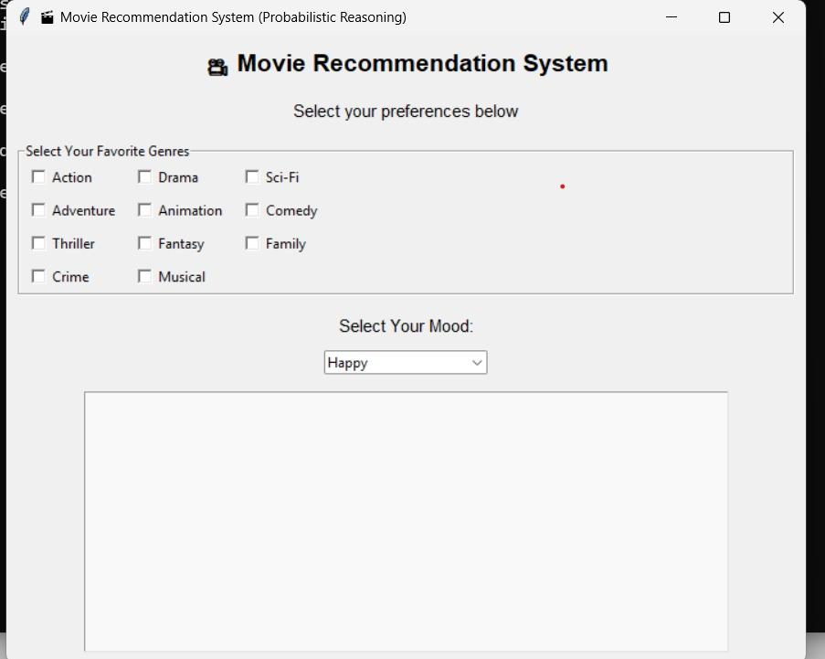
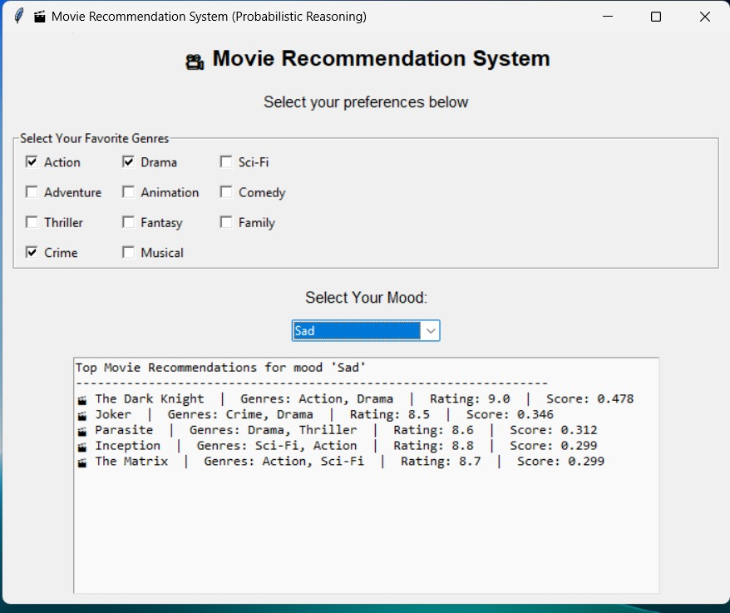
OUTPUT AND RESULTS
:The probabilistic reasoning model successfully predicted suitable movie recommendations based on user moods and genres.
:The GUI-based system provided an interactive and user-friendly interface for testing various input combinations.
:The results validated that Bayesian probability-based reasoning effectively handled uncertainty in user mood and preferences.
:Movies with higher probability scores were shown to better align with user expectations, proving the model’s capability to prioritize relevant recommendations.
:The system achieved accurate and logical recommendations, improving personalization and decision support for users

Slide 6
REFERENCES
1. Artificial Intelligence: A Modern Approach by Russell & Norvig ;
[https://aima.eecs.berkeley.edu/](https://aima.eecs.berkeley.edu/) ([aima.eecs.berkeley.edu][1])
2. Recommender Systems Handbook (2nd Ed., Ricci / Rokach / Shapira) ;
[https://link.springer.com/book/10.1007/978-1-4899-7637-6](https://link.springer.com/book/10.1007/978-1-4899-7637-6) ([SpringerLink][2])
3. Machine Learning: A Probabilistic Perspective by Murphy :
[https://research.google/pubs/machine-learning-a-probabilistic-perspective/](https://research.google/pubs/machine-learning-a-probabilistic-perspective/) ([research.google][3])

